Slide 1
Sentiment Analysis Using BERT
A machine learning model for analyzing sentiments

Slide 2
Team Member
1 –Ahmed Mohamed Abd Alkreem
2 – Idirs Tarek Elsayed awad
3 – Tarek Hisham Mohamed
4 – Ziad Mostafa Megahed

Slide 3
Introduction
Objective:
Sentiment analysis is the process of identifying and categorizing opinions expressed in text.
Applications include:
- Customer feedback analysis
- Social media monitoring
- Brand sentiment tracking

Slide 4
Problem Statement
Problem:
With growing text data, businesses need to understand customer sentiment.
Goal:
To develop a model that classifies text as positive, negative, or neutral using BERT and PyTorch.

Slide 5
Dataset Overview
Dataset Source:
Text data like product reviews or tweets, labeled as positive, negative, or neutral.
Preprocessing:
Removing stop words
Remove unnecessary characters
Lowercasing text
Tokenization
Padding sequences
lemmatization

Slide 6
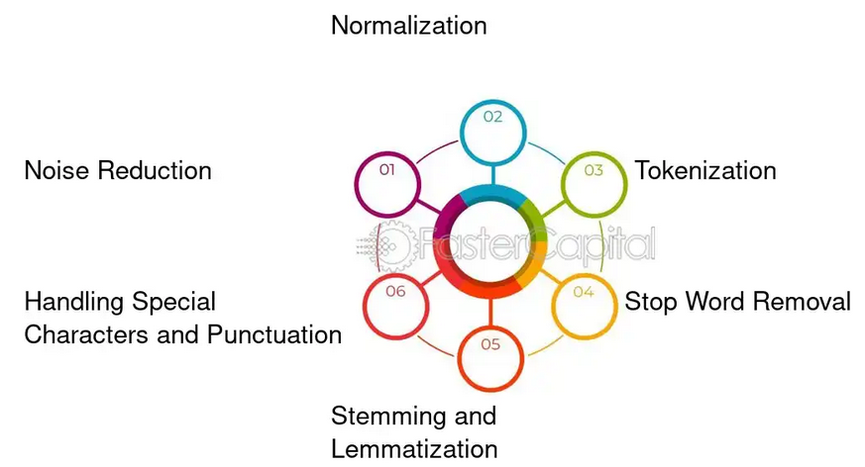
Preprocessing
Removing stop words
Remove unnecessary characters
lemmatization

Slide 7
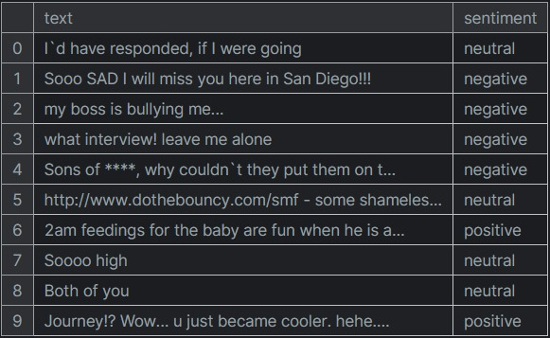
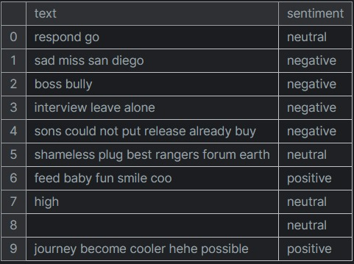
Before Preprocessing
After Preprocessing

Slide 8

Model Overview
Model Used:
BERT - Bidirectional Encoder Representations from Transformers.
Framework: Tensorflow.
Key Features: Contextual word representation, handles long sentences.

Slide 9
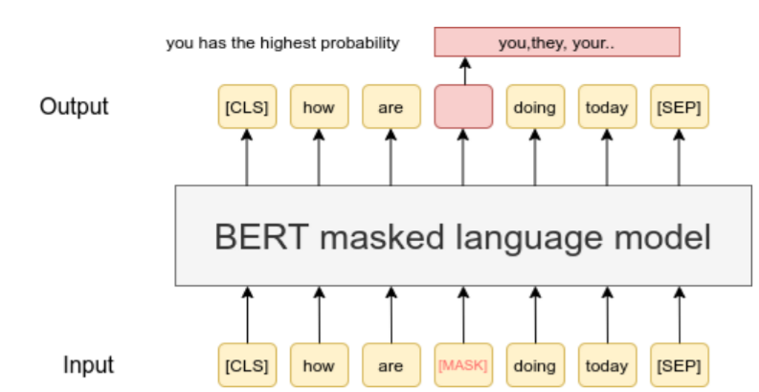
Masked
Language
Model
(MLM)

Slide 10
Training Process
Training Details:
Fine-tuned BERT model on sentiment dataset.
Optimization: Adam optimizer (learning rate 1e-5).
Epochs and Batch Size: 10 epochs, batch size 32.

Slide 11
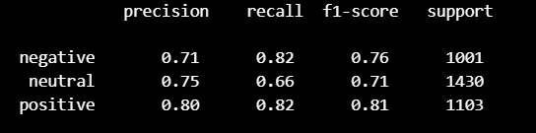

Evaluation and Metrics
Classification Report
Evaluation Report

Slide 12
Challenges Faced
Model Complexity:
BERT is resource-intensive and requires substantial computational power.
(Three Hours)
Handling Imbalanced Data: Class imbalance impacted performance.

Slide 13
Deployment Using Streamlit
Deployment Details:
Streamlit is used for real-time sentiment analysis deployment.
Key Features:
- Real-time predictions based on user input.
- Interactive and user-friendly interface.
Code Overview:
Streamlit loads the trained BERT model from the 'tf_model.h5' file, takes text input, and outputs the sentiment (positive, negative, or neutral).

Slide 14
Conclusion
Summary:
Successfully implemented sentiment analysis using BERT and PyTorch.
Future Work: Larger datasets and advanced preprocessing to improve model performance.

Slide 15
Thank You
Thank you for your attention! Any questions?

